Slide 1

1.6 Building Predictive Model
© London Academy of IT, www.londonacademyofit.co.uk

Slide 2
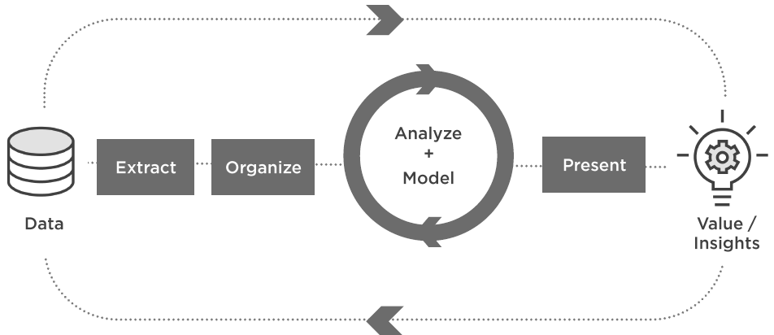
Data Science Project Life Cycle

Slide 3
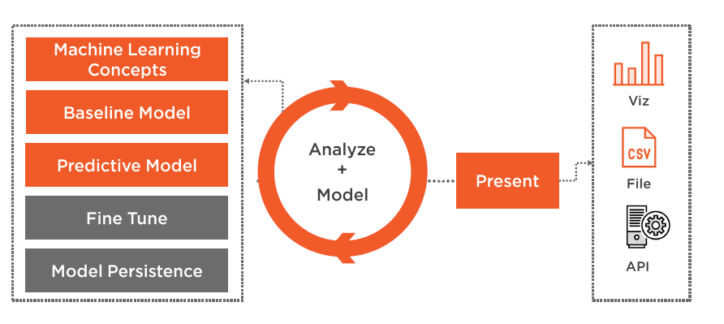
Data Science Project Life Cycle

Slide 4
Session Overview
Machine Learning Basics
Classifier
Logistic regression model
Titanic disaster challenge
Metrics
Baseline Model

Slide 5
Machine Learning
Learning from data or examples

Slide 6

Spam Detection

Slide 7
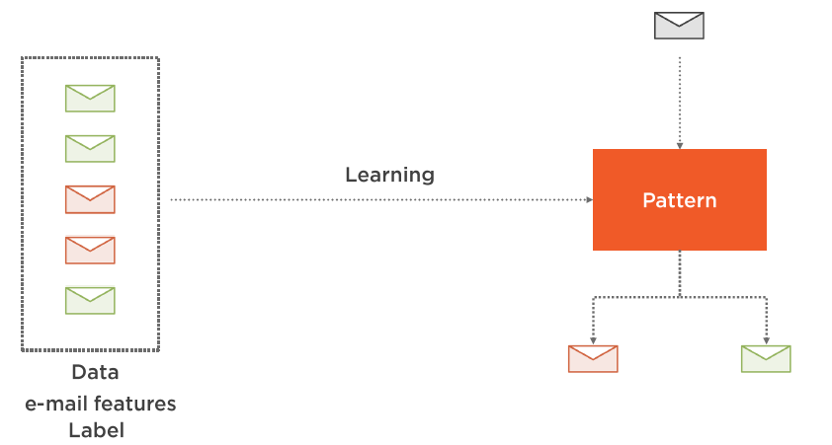
Spam Detection

Slide 8
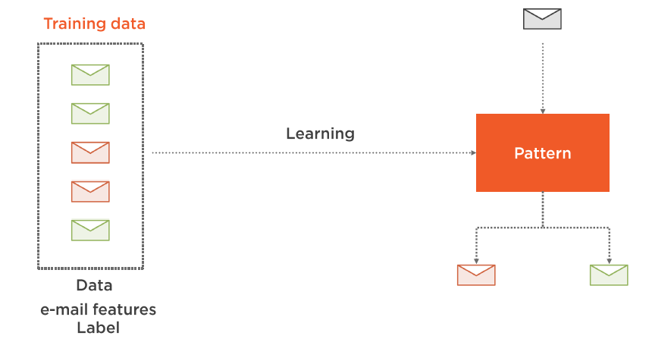
Training Data

Slide 9
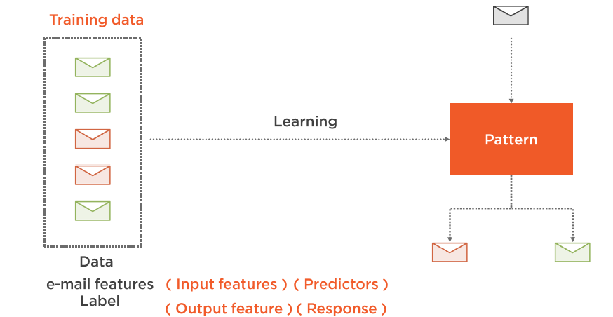
Input / Output Feature

Slide 10
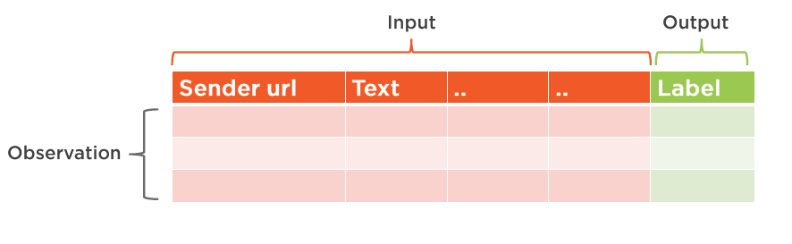
Representation

Slide 11
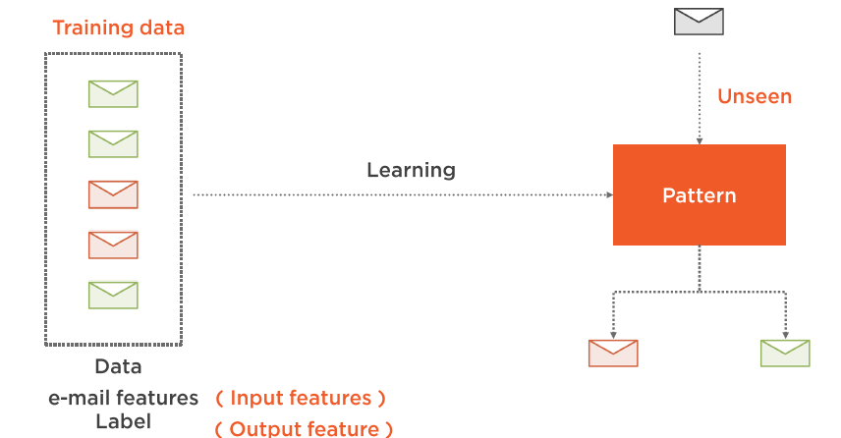
Generalization

Slide 12
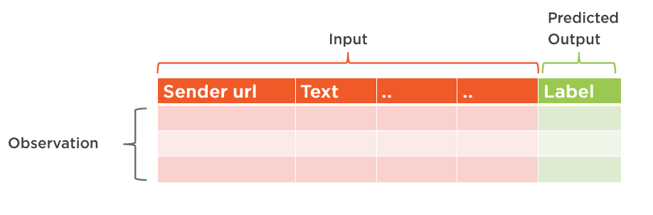
Test Data

Slide 13
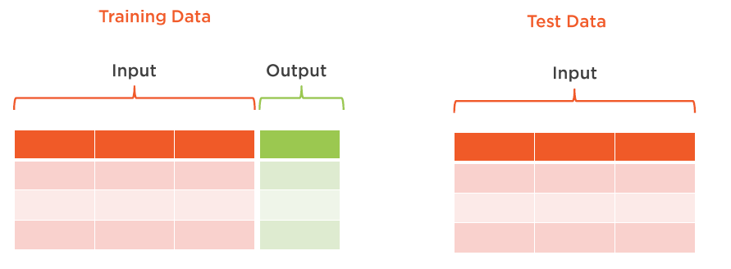
Supervised Learning

Slide 14
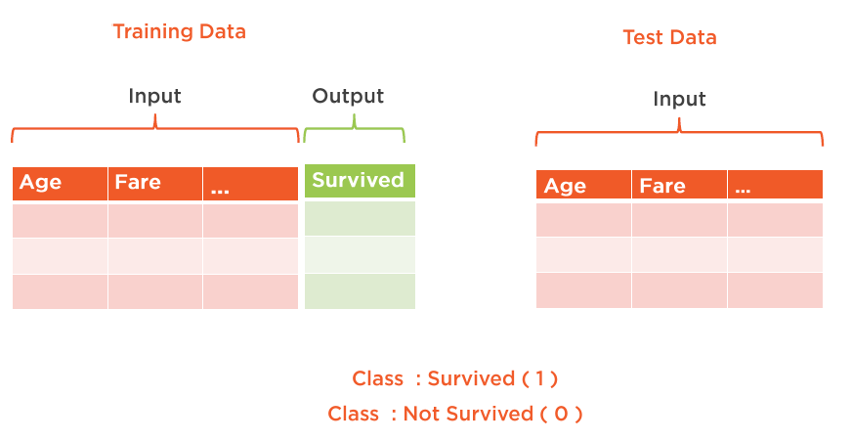
Titanic Disaster

Slide 15
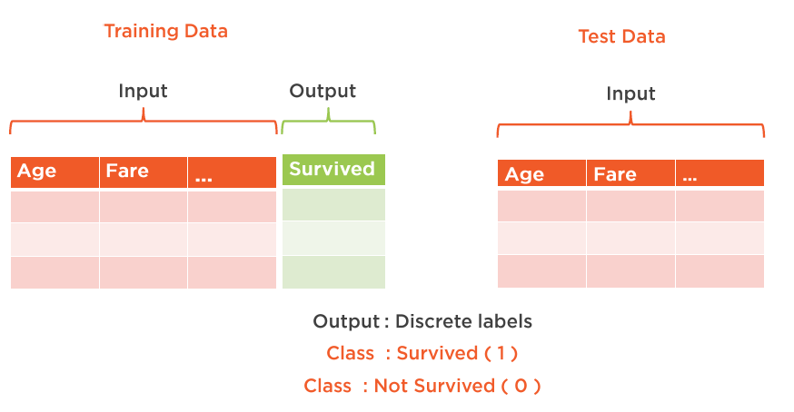
Classification

Slide 16
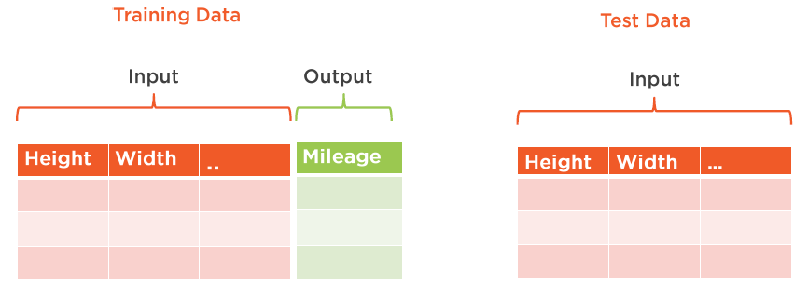
Regression

Slide 17
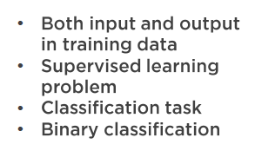
Titanic Disaster Challenge

Slide 18
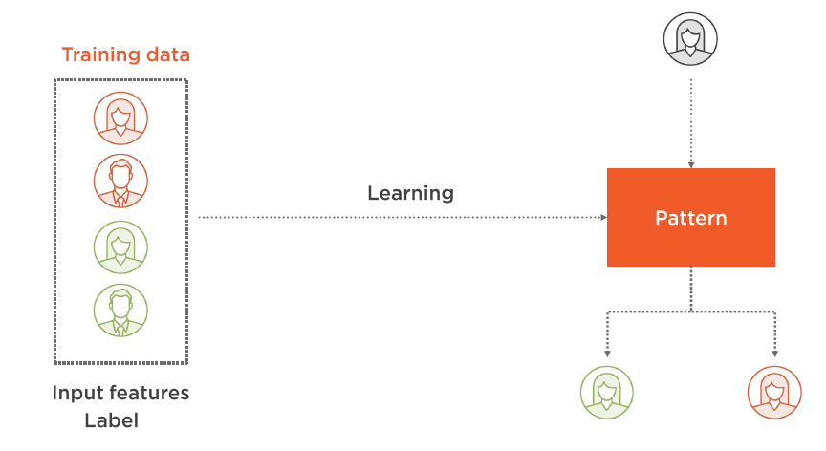
Titanic Challenge

Slide 19
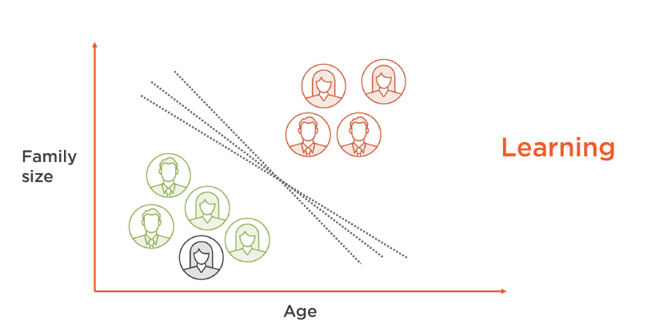
Classifier

Slide 20
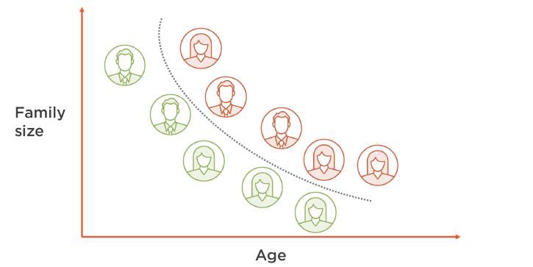
Classifier

Slide 21
Classifiers
Logistic Regression
Support Vector Machine
Neural Networks
Random Forest

Slide 22
Compare Model Performance - Performance Metrics
Accuracy
Precision
Recall

Slide 23
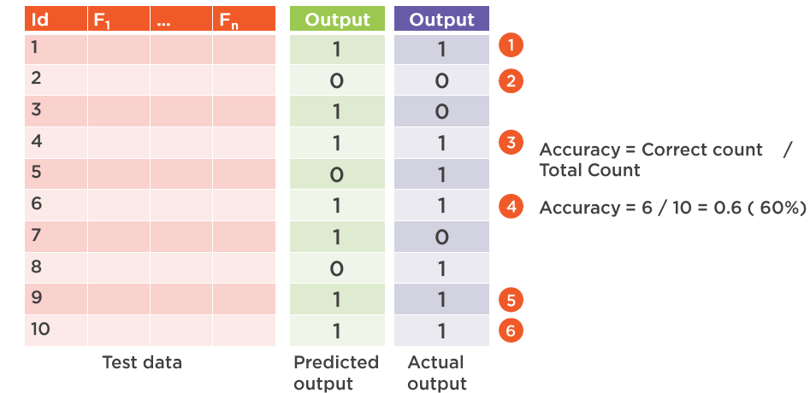
Accuracy

Slide 24
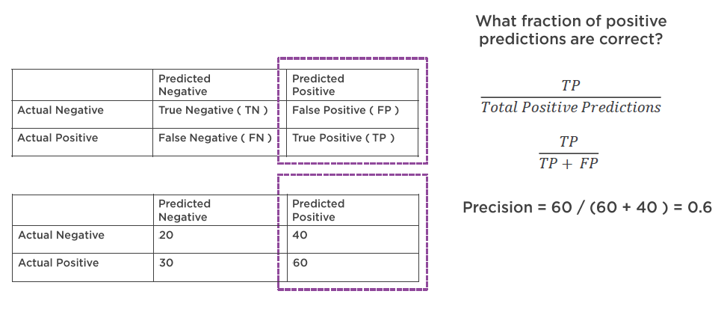
Precision

Slide 25
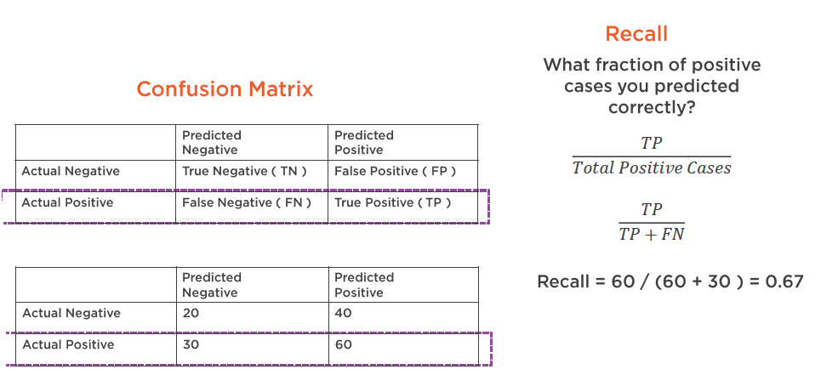
Recall

Slide 26
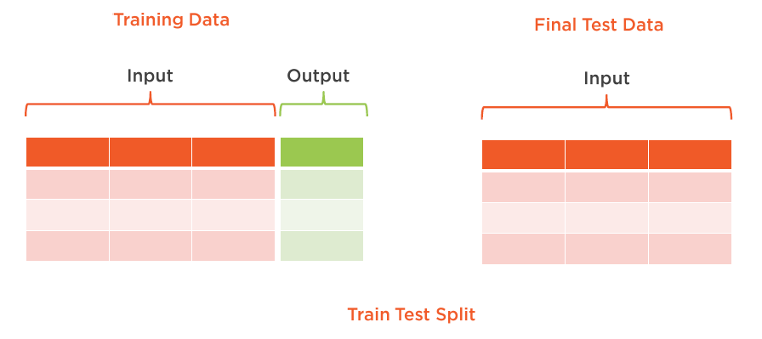
Classifier Evaluation

Slide 27
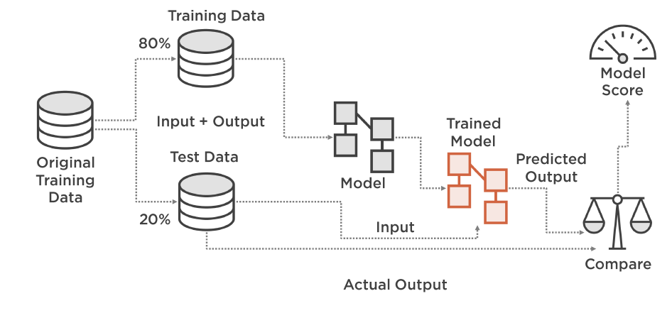
Classifier Evaluation

Slide 28
Baseline Model
First Step
Don’t Skip
Compare

Slide 29
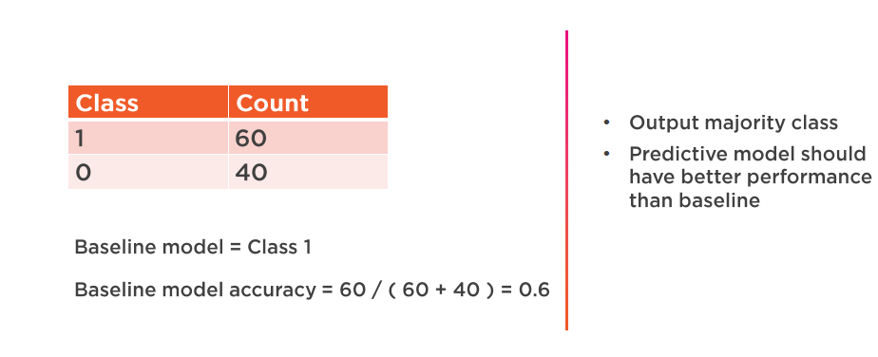
Baseline Model for Classification

Slide 30

Building Model - Demo
Building Model using Python NumPy and Pandas

